Slide 1
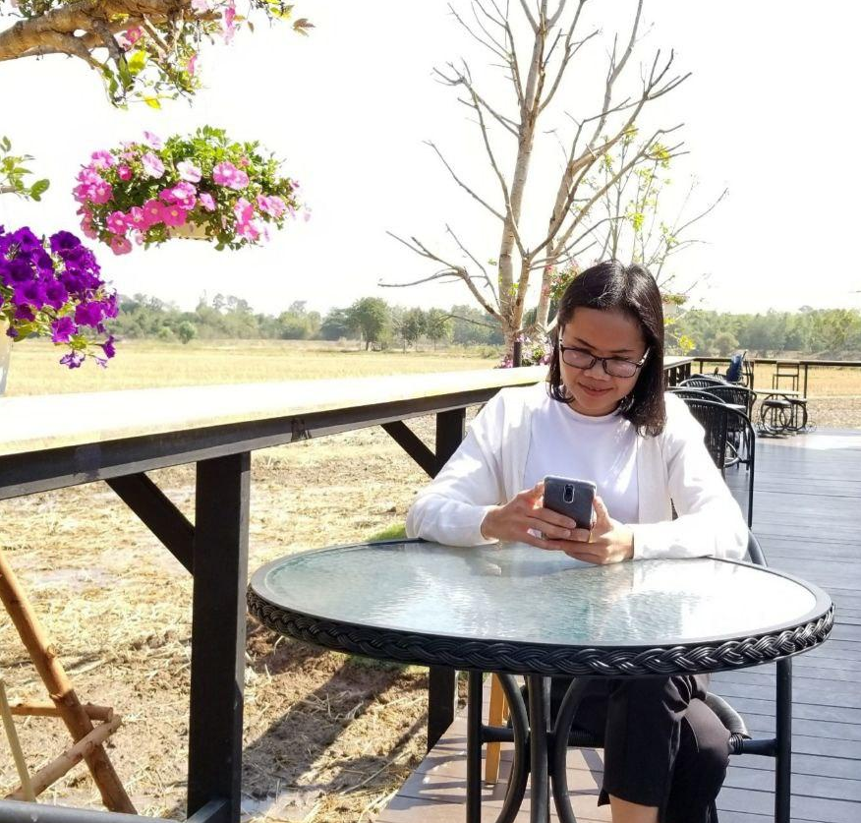
Royal University of Agriculture Faculty of Agro-industry
Subject: Logistic Management and inventory planning
Lecturer: Sem Tevin
Prepared by
Ms. Student name
Bachelor in Agro-industry

Slide 2
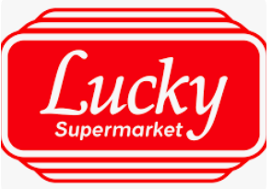
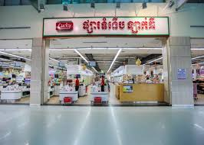

Developing a Logistics Strategy for Lucky Supermarket in Cambodia

Slide 3
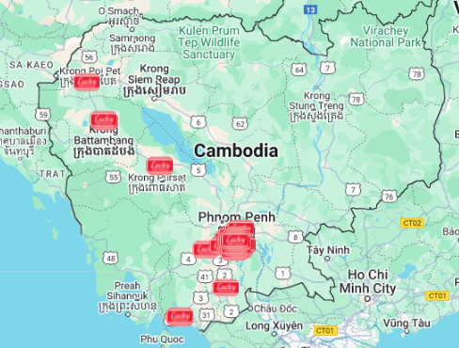
Objective of the Study
Develop a logistics strategy to enhance efficiency, reduce costs, and improve customer satisfaction Lucky Supermarket in Cambodia

Slide 4
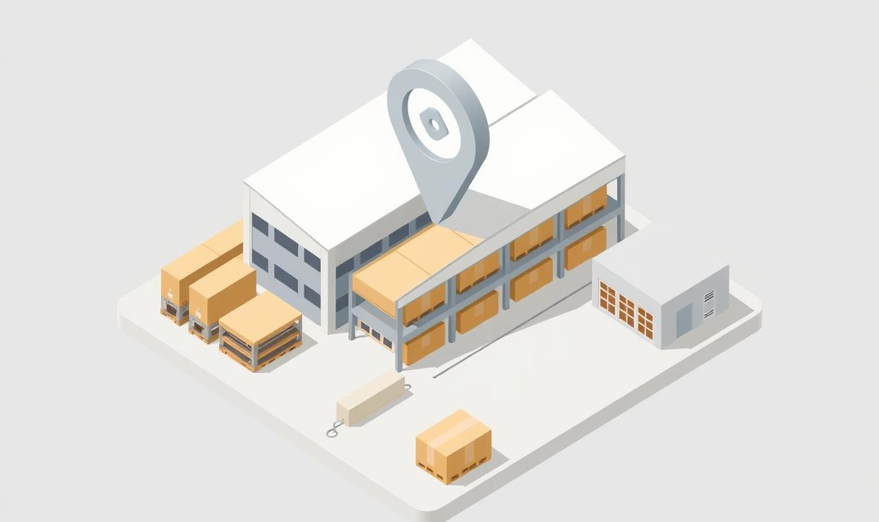
Company Overview
Lucky Supermarket were Established on March 1993 by 4 founders
Mr. Heng Hang Meng
Mrs. Tang Ly Jian
Mr. Chan Eng Por
Mr. Tang David
CEO : Jose Carlos Reis Bettencourt
89 brunches over 1,300 employees
2020 exceeding US$28 billion.
Email : info@dfilucky.com
Address : No 01, Street 55P, Phum Trong Moan, Sangkat Ou Baek K’am, Khan Sen Sok, Phnom Penh
First Lucky Supermarket Located in Preah Sihanouk Province
named Lucky Preah Sihanouk Supermarket.
Contact
(855) 23 885 722

Slide 5
Company Overview
Selling
Supplier
Requirment
Fresh foods, Grocery
Cosmetics, Beauty,
Skin Care, Health care
Household items
Snacks, Beverages
exclusive brands
.
Thailand
Local farms
Vietnam
Japan
China
European
.
ISO 22000 (food safety)
HACCP
GMP
GAP Certification
.

Slide 6
Key Challenges
How can we reduce inventory costs and late deliveries?
How do we solve the high among of spoilage rate and inefficient temperature storing condition during transportation?
How can we lower our operation costs in the market with Sustainability?

Slide 7
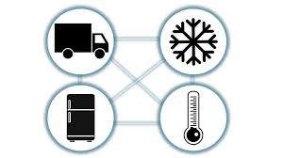
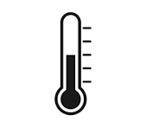
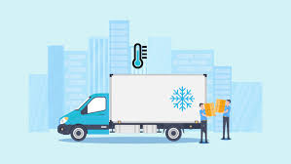

Optimizing Cold Chain
Ambient Storage
Cold Storage (2–8°C)
Frozen Storage (-18°C)
Temperature Tracking
Sensors monitor storage conditions 24/7

Slide 8
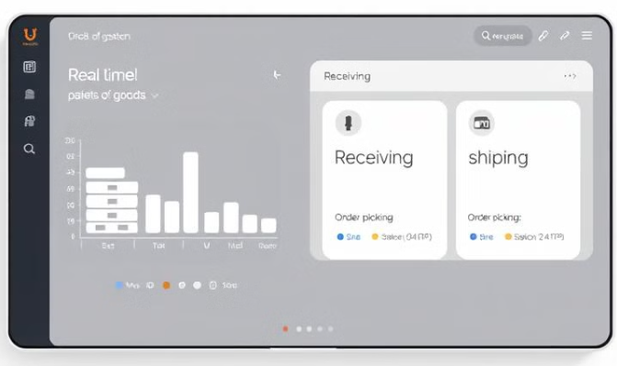


Optimizing Inventory\Warehouse Management
Stock Availability
Monitor stock levels 24/7
Real-Time Management
Track products Location 24/7
Robotics
Automatic handling
Warehouse Management Systems
provides 24/7 supply chain visibility
Central Warehouse Location
Phnom Penh, Preah Sihanouk near major markets /border points

Slide 9

Optimizing Transportation
Trucks
Air Flight
Ship
Motorbike
Third-party logistics (3PL) services.

Slide 10
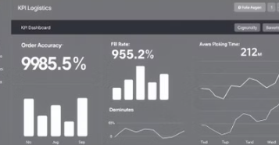
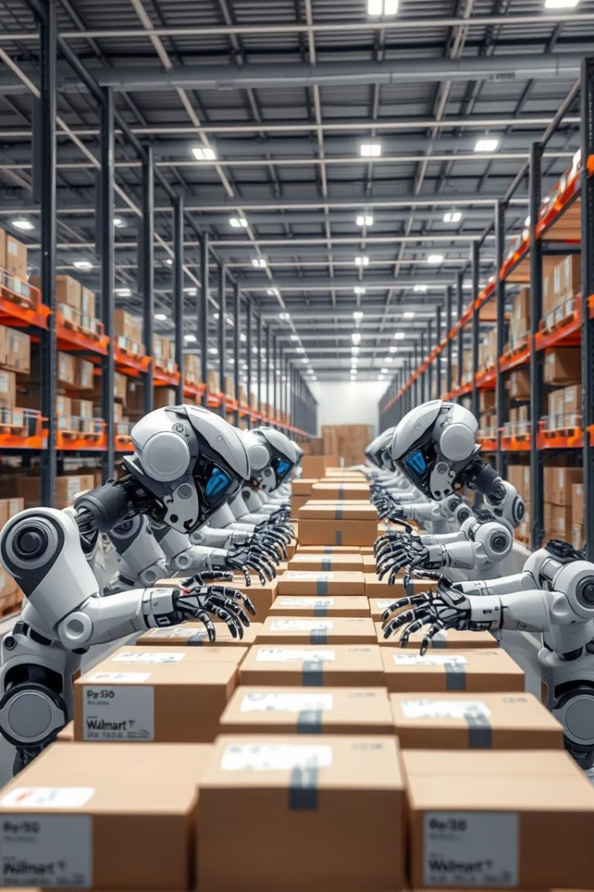
Apply Technology & Digitalization
Create data systems that be able to access data across procurement, inventory, stocks, orders, and finance
Create dashboard that provide information on Demanding or trending products
Create dashboard that summarize inventory optimization, delivery time, Total loss, Total revenue
Device tracking on vehicle health, fuel usage, GPS,
Smart warehousing on temperature sensors, asset monitoring
Use Robot Automation QR code scanning, Digital order picking, and Robotic sorting or handling

Slide 11

Sustainability Considerations
Optimize delivery routes and avoid traffic jam to cut down on fuel usage
Using electric trucks or electric bike or other transportation which is more sustainable in category road, rail, air, maritime (sea), and pipeline transport.
Using recyclable or biodegradable materials
Applying reverse logistics for returns
As the result These things can reduce the operator costs

Slide 12

My Logistics Advantage at Lucky Supermarket
Summary: Detailed analysis of Trending/Demanding product + Product Quality + Variety Deliveries + Inventory/Warehouse management with Smart technology adoption + trusted partnerships and trusted suppliers; with these things I am confidently that this logistics strategy is efficiency, reduce costs, and improve customer satisfaction Lucky Supermarket in Cambodia

Slide 13

Thank you for your attention!
Ms. Sem Tevin
ID: 80-221010
Master in Human Resource Management.
Email: tevinsem@rua.edu.kh

